Slide 1
Letters Across the Pond
A Digital Library Project
Jonathan Tweedy
S652 – Fall 2010

Slide 2
Project Overview: Goals
System for maintaining scans and transcriptions of correspondence, and marking up textual references to entities such as people and places
Small-scale Goal: Repository for letters from expatriates to families back home in the U.S., starting with a set of letters from Patricia Tweedy to her parents.
Large-scale Goal: Repository for letters of any kind with references to people and places stored in one or more databases; flexibility in implementation, and adaptability to a variety of data sources containing information about people, places and their relationships.
Open to the public for document upload, transcription and markup

Slide 3
Project Overview: Usefulness
Document cultural experiences living abroad
Maintain records of reference to people and places within written correspondence for genealogical study
Internationalize our knowledge of interpersonal relationships beyond the more common channels like high school graduation and genealogical records.

Slide 4
Interface Preview (in progress)
http://cafenapkin.com/S652/interface

Slide 5
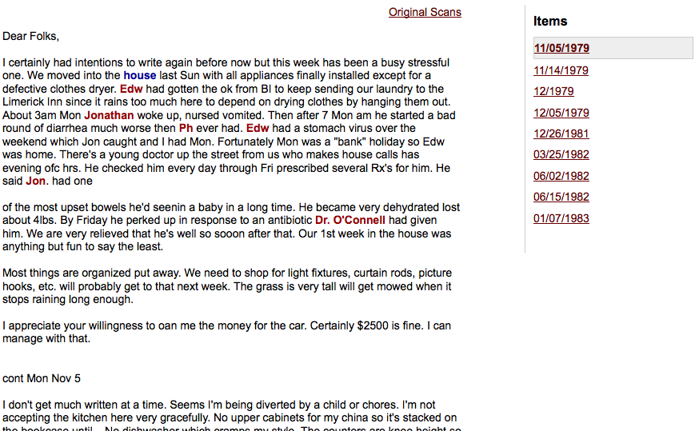
Interface Preview (in progress)

Slide 6
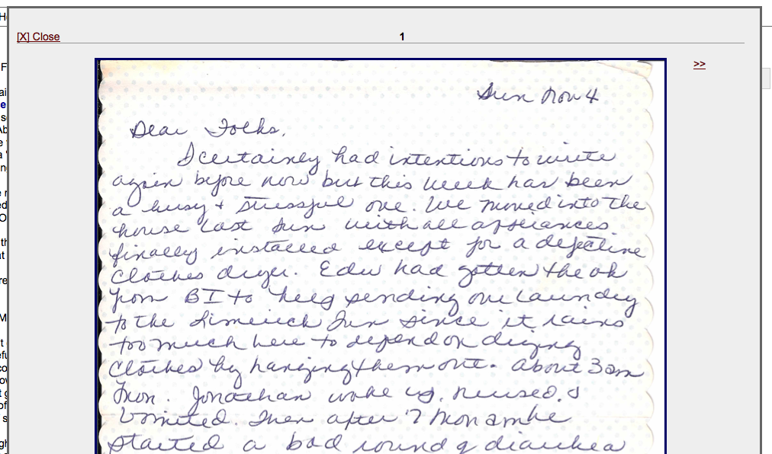
Interface Preview (in progress)

Slide 7
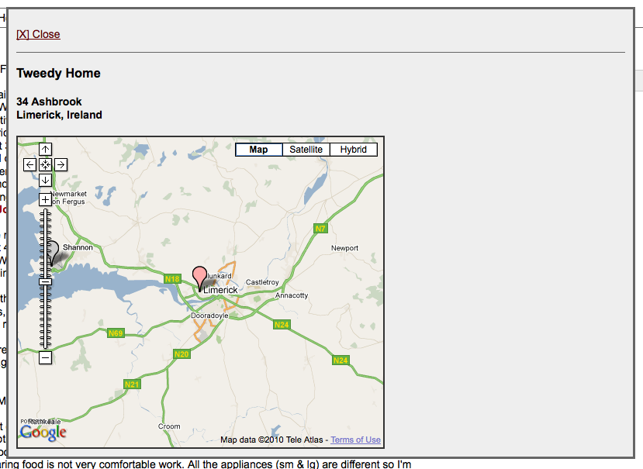
Interface Preview (in progress)

Slide 8
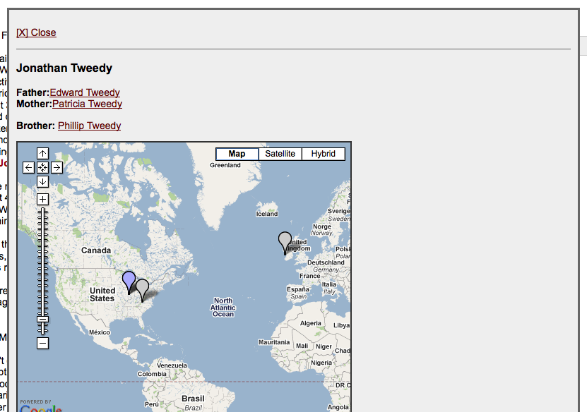
Interface Preview (in progress)

Slide 9
Tech Specs: Web Application
Hosted on a LAMP server (HostGator.com)
MySQL database
PHP server-side scripting
JavaScript/Ajax on front end:
Pop-up info
Google Maps API

Slide 10
Tech Specs: Metadata & Markup
Because relationships and collection data are stored in a database, collection metadata (DC, MODS, etc.) can be generated in different formats as needed.
Individual letters can be marked up more or less detail, either using TEI or HTML. The average public user will have limited markup experience, and is more likely to know a little HTML than a little TEI. Many may just want to enter raw text and use the markup tool to tag people and places. An HTML/TEI/Plain option could be provided.
Browsers will typically ignore most markup other than those shared by HTML specification. An additional “ignore line breaks” option, or a drop-down menu of entry formats could be used to allow manual metadata entry without auto-replacing line breaks with <br /> tags, and/or re-format the output depending on the entry format chosen.

Slide 11
Tech Specs: Integration
The back-end scripts have been developed so that they can be minimally modified to use alternative data sources (for example, a genealogical database), and perform slightly different operations, to deliver JSON output to the JavaScript that displays the People and Place information
The front end only needs to be modified if you want to change the look of the interface or modify fundamentals of the user experience.

Slide 12
Digitization Process
Create new collection entity (if not adding to an existing one)
Enter new people & place entities as needed*
Create instance(s) of letter(s) and enter markup
Upload one or more images** for each letter
Letters and images will be re-orderable within their respective collections and letter instances.
*Can provide the option of entering people and places during markup as needed. Entity integrity is an issue to be resolved on a broader scale (example: Facebook religions), and will rely on compatibility with existing genealogical resources.
**In a web environment, it’s not ideal to store and display full-size TIFFs, and longer-term archiving logistics is a problem that remains to be solved for this project. The proposed interface would allow uploading web-friendly sizes and formats.

Slide 13
Property Rights
Older letters, where available and provided by the owners, are not an issue.
More recent letters are gray area: the author may or may not be living to grant permission, but if the recipient is willing to make them available, then perhaps they can be used in the ‘formal’ collections
For a web application open to the public, perhaps take a stance similar to YouTube and other publicly-uploaded media sites, in which copyright violation claims are investigated as needed.

Slide 14
Staffing Requirements: Development
Web Programmer
3 Months: develop and test collection upload/management interface
3 Months: improve interactivity (concurrent) and conduct usability studies
Collection Development Staff (maybe)
3 Months (during 2nd 3 months above) to collect letters and enter data, including people and places, as well as letter markup referencing them

Slide 15
Staffing Requirements: Maintenance
Part-time web programmer for system improvement, repair and other maintenance. May be funded/staffed from within a larger organization. (In other words, the larger library system maintaining the project may allocate some of a developer’s time to the project as needed.)
Part-time entry of occasional new ‘formal’ collections/items as needed. (Again, may just be performed by staff within a larger project/organization.)

Slide 16
Costs (System)
Programming:
So far: $25/hour* x 20 hours = $500
Next Phase: $25/hour x 60 hours = $1,500
Usability Testing/Refinement: $25 x 80h = $2,000
*(Based roughly on my IU hourly rate.)
Server space:
12 months x $15/month = $180/year
(Large-scale implementation could cost significantly more.)
Domain Name Registration:
$12/year
+ The cost of a specific implementation for a Digital Library Project
Notes:
Cost for a formal implementation (an actual ‘collection’) could vary significantly, and I haven’t worked out the numbers for that so far. Ideally I’d actually prefer to find grant money to fund the development of the system itself, but I think I’ll write up the proposal from the perspective of someone developing such a system in the context of a thematic project. I only have 9 letters for the current collection, but will formulate cost estimations based on significantly more collections, each containing as many or more letters and more thoroughly documented people and place entities.

Slide 17
What Next?
Develop a more extensive and complete example of the system in action, with my own family’s correspondence as an example
Make the system available as an open-source package for personal/local collection/system use.
Explore opportunities to partner with existing genealogical resources to make it available as a centralized online service.
Prefer to keep it free
Explore solutions to certain technical/data challenges…

Slide 18
Challenges
People and Place Entity Identification:
Maintaining Uniqueness (especially if dealing with multiple data sources that may have overlapping ‘unique’ ID numbers)
Recognizing Sameness (avoiding duplicate entries in the People and Place databases, or among multiple sources)
Obtaining People and Place Data
Facebook: optional parent/sibling relationships
Requires opt-in (by allowing the app)
Genealogical Record Holders:
Genealogy.com
Ancestry.com
Other Commercial/Paid Services

Slide 19
fin

